Slide 1
Social Interaction
Sara Muneeb
sara.muneeb@cuilahore.edu.pk
Computer Science Department

Slide 2

Introduction
People are inherently social: we live together, work together, learn together, play together, interact and talk with each other, and socialize.
Different applications afford different ways of supporting how people connect with each other.

Slide 3
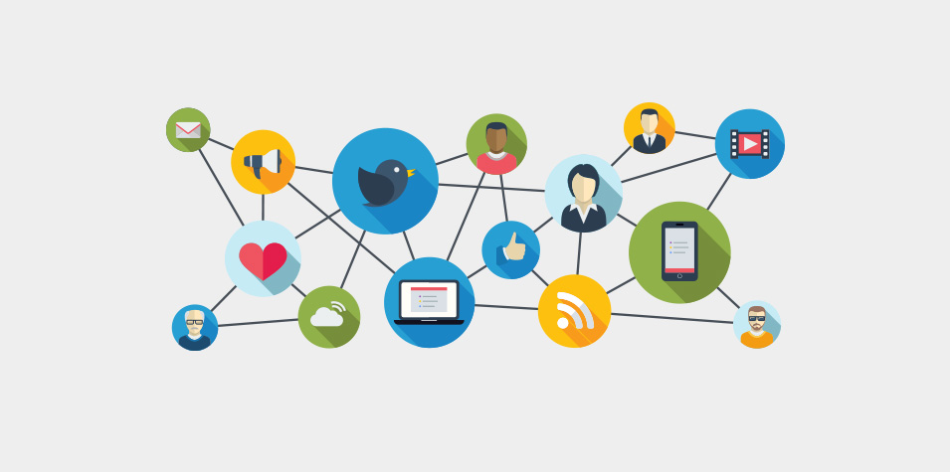
Being Social
A fundamental aspect of everyday life is being social, and that entails interacting with each other.
Personal
Professional
What are pros and cones of being social via technology?

Slide 4

Examples
Technologies have been designed to encourage social interaction to good effect.
Amazon Echo
Open the Magic Door

Slide 5
Face to face Conversation
Talking is something that is effortless and comes naturally to most people.
Conversation Mechanism
Rule 1 The current speaker chooses the next speaker by asking a question, inviting an opinion, or making a request.
Rule 2 Another person decides to start speaking.
Rule 3 The current speaker continues talking.

Slide 6
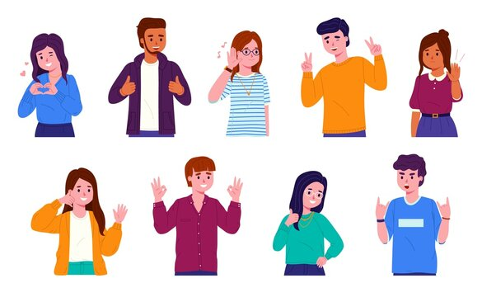
Nonverbal Communication
Detecting Breakdowns
Facial Expressions
Back Channeling
Voice Intonation
Gesturing
Body Language

Slide 7
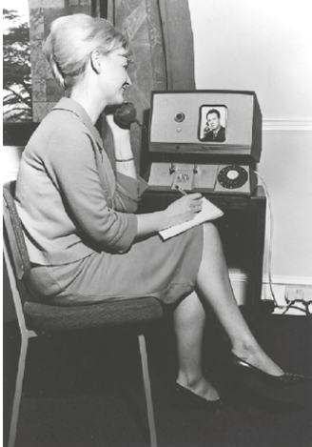
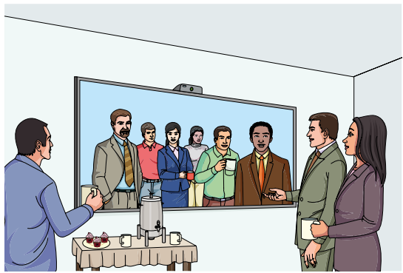
Remote Conversations
Video Phone
Video Window

Slide 8
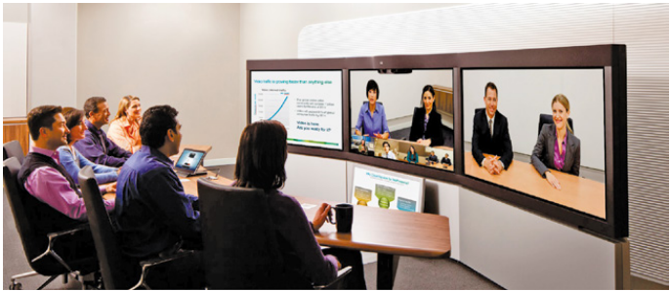
Example
Telepresence Room

Slide 9

Example – Facebook Spaces
Facebook vision of socializing in 3D world

Slide 10
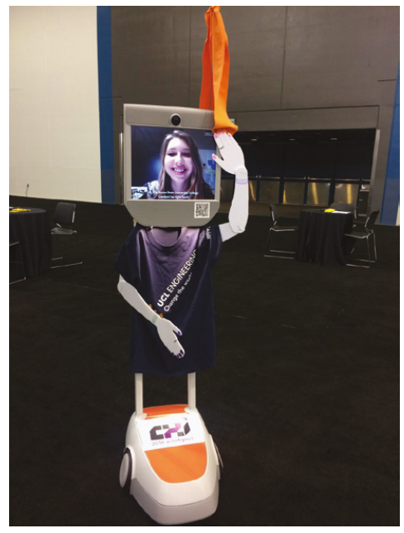
Example – Beam Robot

Slide 11
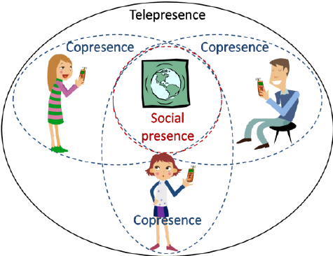
Co-presence
It is occurrence of two or more things together in the same place and time.
The motivation behind this is to enable co-located groups to collaborate more effectively when working, learning and socializing.
Physical coordination
Awareness
Shareable interfaces

Slide 12

Social Engagement
Refers to participation in the activities of social group.
It is voluntary and unpaid

Slide 13
Conclusion
Being Social
Face to face conversations
Non verbal conversations
Remote conversations
Co-presence
Social engagement

